Slide 1

English 9
UNIT 2: CITY LIFE
Lesson 6: SKILLS 2
Welcome to our class
MAI THI HUONG GIANG

Slide 2
I. LISTENING
1. Does your city, or the one nearest to you, have any of these drawbacks?
urban sprawl: (sự bành trướng đô thị
air pollution: (ô nhiễm không khí)
noise: (tiếng ồn)
bad weather: (thời tiết xấu)
high cost of living: (sinh hoạt đắt đỏ)
crime: (tội phạm)
traffic jams: (tắc đường)
overcrowding: (quá đông đúc)
)

Slide 3
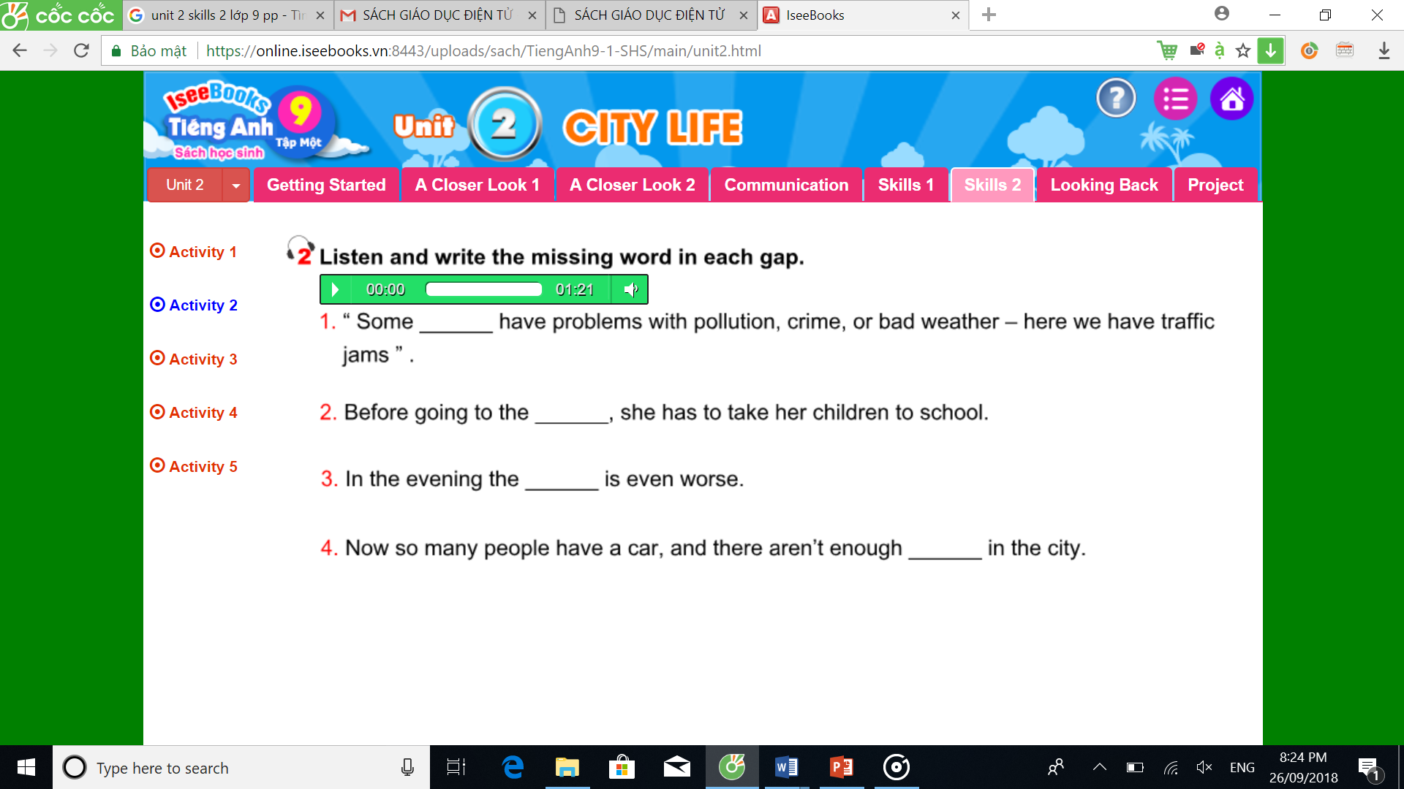
cities
office
traffic
roads

Slide 4
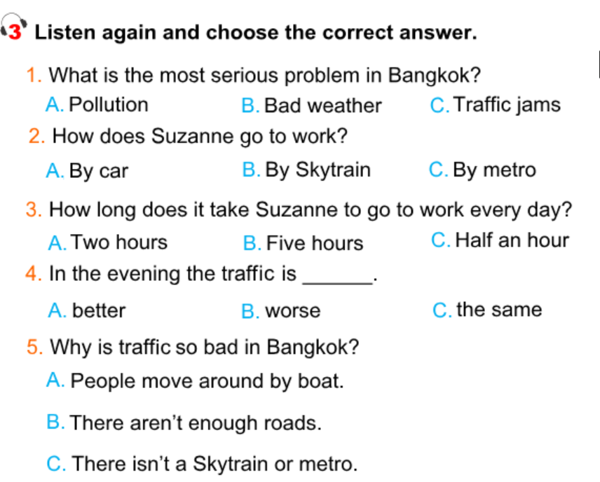

Slide 5
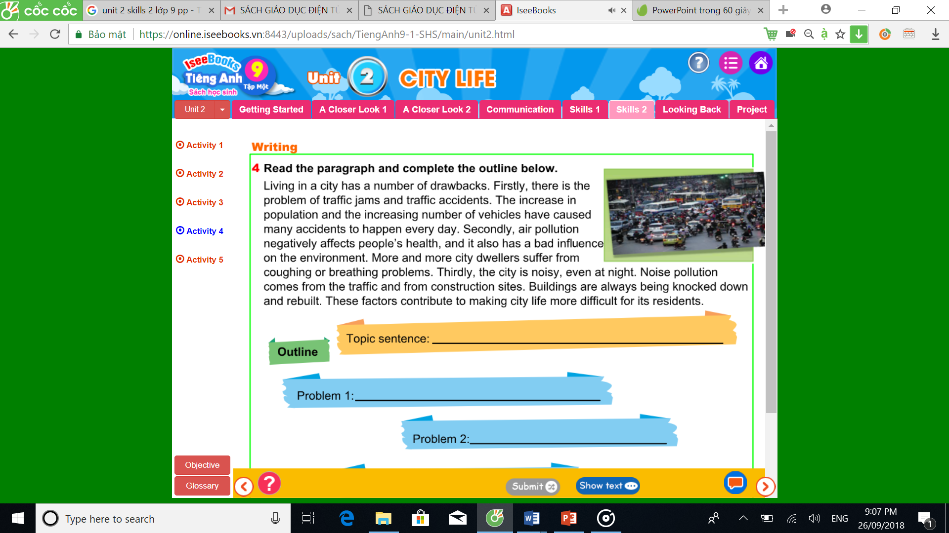
II. Writing

Slide 6
II. Writing 4. Read the paragraph and complete the outline below
Topic sentence:
Problem 1:
Problem 2:
Problem 3:
Conclusion:
Living in a city has a number of drawbacks
There is the problem of traffic jams
and traffic accidents.
Air pollution negatively affects people’s
health, and it also has a bad influence on the environment.
The city is noisy.
These factors contribute to making city life more difficult for its residents

Slide 7
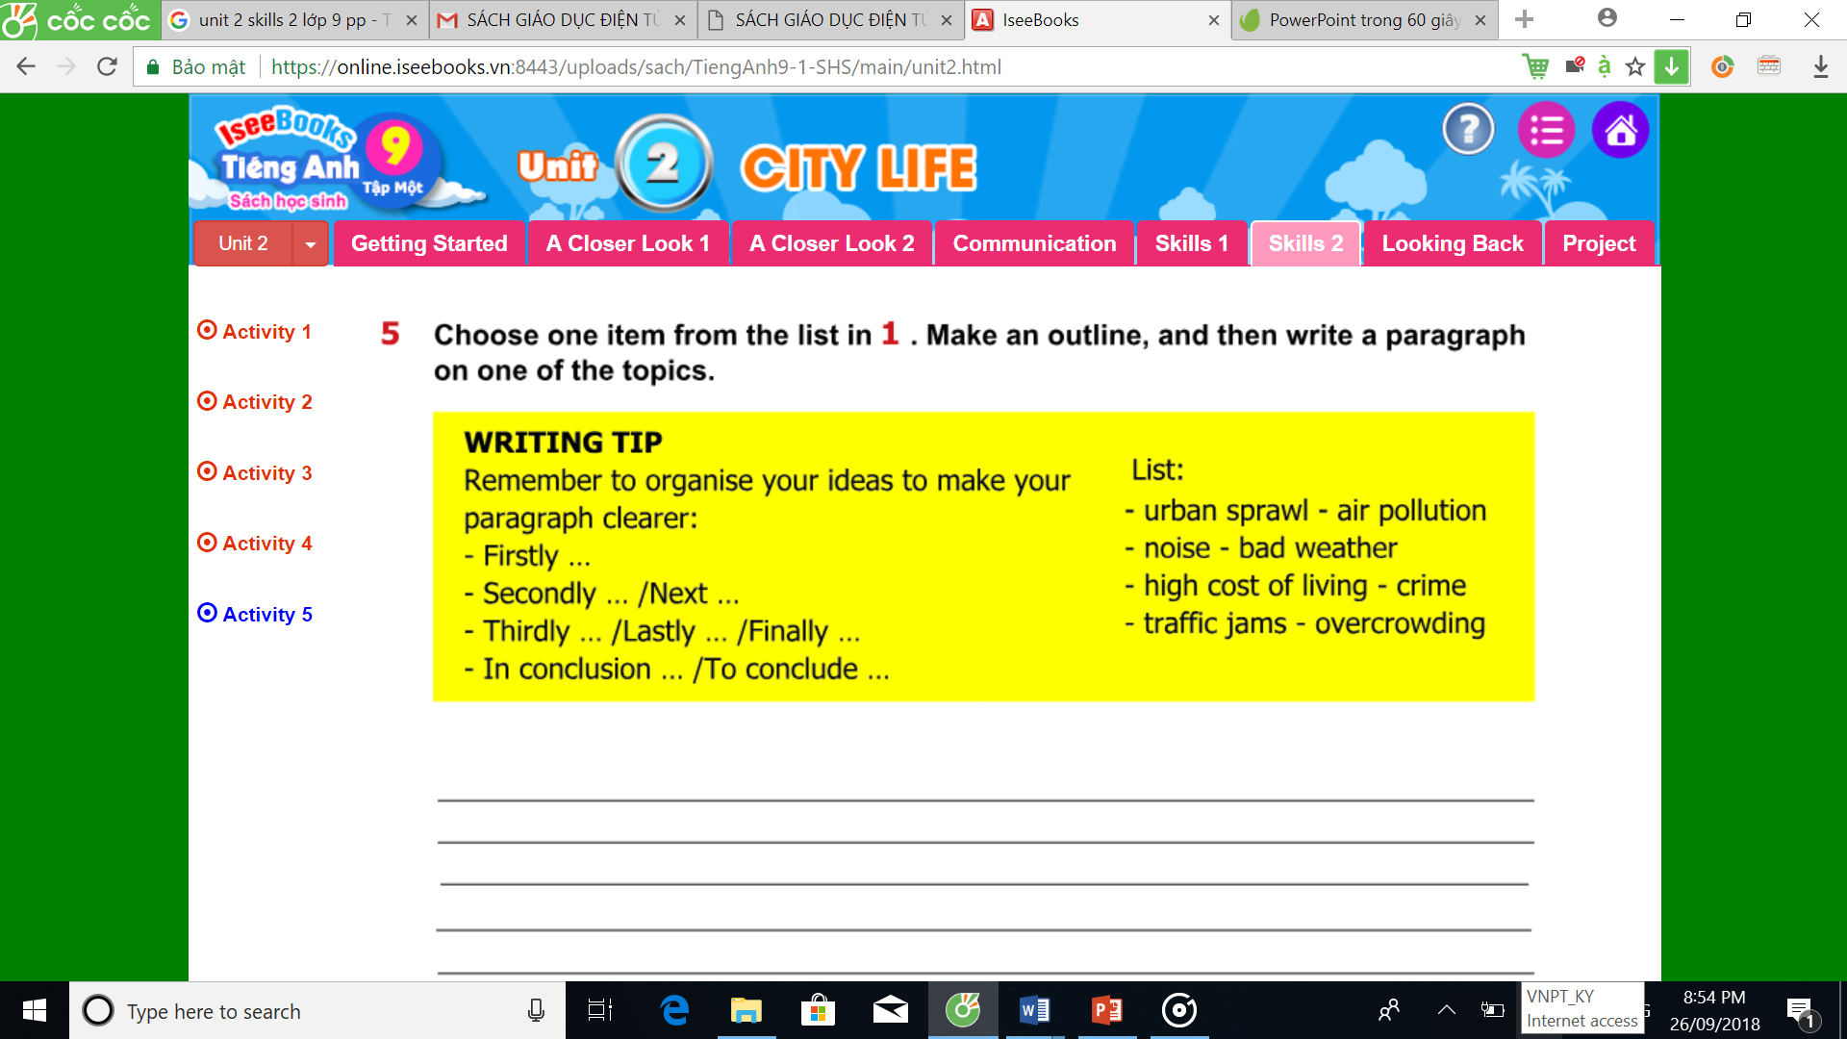
5. Choose one item from the list in 1. Make an outline, and the write a paragraph on one of the topics

Slide 8
Suggestion: There are a lot of disadvantages of living in a big city, air pollution is among the most serious problems. Firstly, air pollution comes from the factories in the city. Big cities attract a lot of both inside and outside investments, so the number of factories is increasing quickly. This makes the air extremely polluted by smoke from factories. Secondly, that there are too many transportation means also makes this problem worse. Exhaust from cars, motorbike is one of the factors that make the air polluted. To conclude, air pollution, which contributes to making more and more people get many serious diseases, such as lung cancer, tuberculosis and so on, is a big drawback of city life.

Slide 10
Homework
Learn by heart the new words.
Speak with your friends
Prepare for the next..

Slide 11


